Slide 1
Global Software Services MI
Corporate Research Desk
Sep 27,2012

Slide 2







Global Software Services MI: Table of Content
Market Overview
Competitive Landscape
Deals Space
Business Trends
Technology Trends
Market Drivers
Market Future
Disclaimer:
The information presented in this report is based on data available in the public domain. If you find that it is incorrect, please let us know.
- 2 -

Slide 3
Global Software Services MI: Table of Content
Market Value
Market Overview
Market Segment
Competitive Landscape
Software Value Chain
Deals Space
Software Supply Chain
Business Trends
Technology Trends
Market Drivers
Market Future
Disclaimer:
The information presented in this report is based on data available in the public domain. If you find that it is incorrect, please let us know.
- 3 -

Slide 4
Global Software MI: Market Overview Market Value
Market Value
The computer software market consists of systems and application software
Systems software comprises operating systems, network and database management and other systems software
Application software comprises general business productivity and home use applications, cross-industry and vertical market applications, and other application software
The global software market had total revenues of $265.4 billion in 2010, representing a CAGR of 4.2% between 2006 and 2010
Global software market value: $ billion, 2006–10
The performance of the market is forecast to accelerate, with an anticipated CAGR of 6.1% for 2010 - 2015, to reach $356.7 billion by the end of 2015.
$ billion
% growth
Global software market value: $ billion, 2006–10
Year | $ billion | % Growth
2006 | 224.9
2007 | 245.8 | 9.3%
2008 | 260.1 | 5.8%
2009 | 247.7 | -4.7%
2010 | 265.4 | 7.1%
CAGR: 2006-10 |  | 4.2%
Year
Notes:
Sources:
Datamonitor: Global Software Publication Date: November 2011

Slide 5
Global Software MI: Market Overview Market Segment
Global software market segmentation by Category: % share, by value, 2010
Category | 2010 ($ billion ) | %
General business productivity & home use | 63.96 | 24.1%
Network & database management | 59.18 | 22.3%
Cross-industry & vertical application | 55.73 | 21.0%
Operating system software | 46.98 | 17.7%
Other system software | 23.36 | 8.8%
Other application software | 16.19 | 6.1%
Global software market segmentation by Geography: % share, by value, 2010
Category | 2010 ($ billion ) | %
Americas | 114.7 | 43.2%
Europe | 83.1 | 31.3%
Asia- Pacific | 53.9 | 20.3%
Middle East & Africa | 13.8 | 5.2%
Notes:
Sources:
Datamonitor: Global Software Publication Date: November 2011

Slide 6
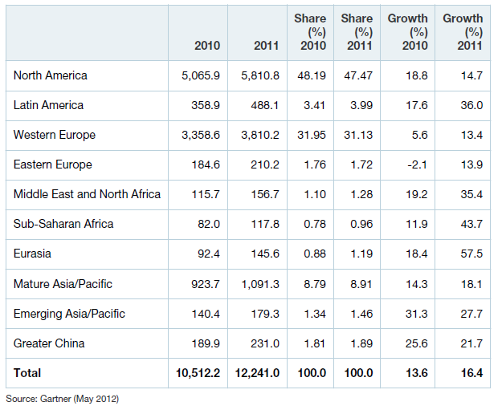
Global Software MI: Market Overview Market Segment
Market Segment- BI Platform, CPM Suite and Analytic Application/Performance Management Market Revenue, Share and Growth by Region, 2010-2011
Marginal vulnerability to macro conditions
Major natural disasters, continued economic weakness in major economies and political uprisings all happened with increased fervency in 2011. Yet all regions grew in the double digits showing that analytics is only marginally vulnerable to macro conditions at this stage in its market development
Mature Regions
Mature regions (North America, Europe and Japan) are characterized by a bigger portion of IT spending being in maintenance mode, in combination with much of the discretionary spending occurring in business units
Emerging Regions
Emerging regions are spending heavily on BI almost across the board but from relatively small bases.
Rapidly growing economies, in combination with a critical mass of information collected from maturing infrastructures and now needing analysis, are prompting this.
The one exception to rapid growth is the Eastern European economies (not counting Russia), which are slumping, and where much of the buying sits with struggling parent companies from Western Europe.
The BRIC countries stood out in particular, with 40% growth. The megavendors in particular see the BRIC countries as strategic and are pouring billions into large research and regional centers, resulting in a virtuous cycle of development there
Notes:
Sources:
Gartner: Market Snapshot: BI, Analytics and Performance Management Software, 2011 Published: 31 May 2012

Slide 7
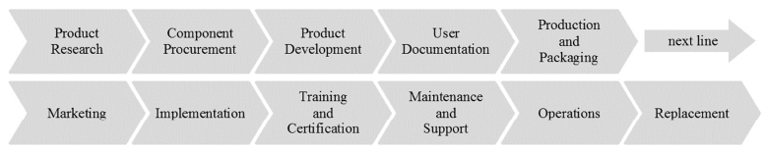
Global Software MI: Market Overview Software Value Chain
Product research activity stems from the conceptualization activity, which comprises the development of a product vision, It is extended by fundamental research and first feasibility checks.
Component Procurement activity is a result of the generic value chain and the major role of components in software creation The procurement of components is similar to the inbound logistics activity from the generic value chain.
Product Development activity entails most of the phases which can be found in software development processes and are concerned with actual creation of the software product itself. Product development is the core activity of a software producing firm and consists of the sub-activities requirements engineering, software design, software development, code documentation, verification, and validation.
User Documentation activity involves sub-activities which document software functionalities and properties for end-users. Actuality, comprehensiveness, and usefulness for end-users need to be ensured via continuous reviews.
Production & Packaging activity comprises the sub-activities assembly. Within assembly, software and respective documentation are bundled to one package and, if applicable, combined with other products.
Marketing activity is associated with providing a means by which buyers can purchase the product and inducing them to do so, like advertising, promotion, sales force, quoting, channel selection, channel relations, and pricing
Implementation activity entails the installation, configuration, and adaptation of the product.
Training & Certification activity entails training of users and third party firms. In addition, certifications attest users and third party firms a certain degree of seniority in the handling of a software product.
Maintenance activity ensures the software product is updated by bug fixes and enhancements.
Operations activity ensures the execution of a product on an information system.
Replacement, primarily deals with the decision, if a legacy system shall be replaced by an alternative system.
- 7 -
Notes:
http://aisel.aisnet.org/cgi/viewcontent.cgi?article=1439&context=amcis2011_submissions&sei-redir=1#search=%22software%20industry%20value%20chain%22

Slide 8
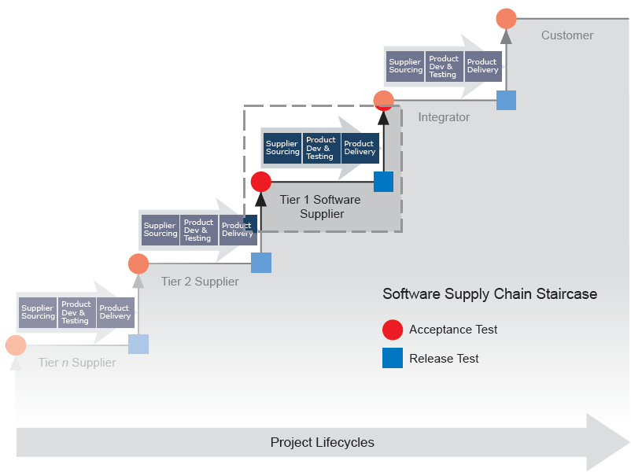
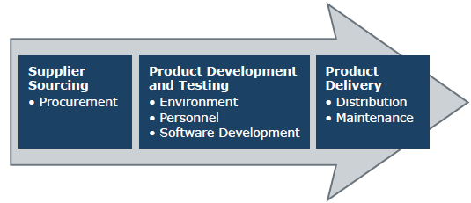
Global Software MI: Market Overview Software Supply Chain
Each supplier in the software supply chain manages three sets of controls
IT solution supply chain resembles a collection of staircases. Each staircase aggregates smaller useful components from different suppliers into an ever-greater collection of components until ultimately sufficient IT components have been assembled to meet the customer’s business requirements.
Components move along this “staircase” supply chain as they are handed off from one supplier to the next.
A supplier can conduct acceptance tests on components received from their suppliers, and release tests on the components they deliver to their customer. That means that each transition of custody along the chain of suppliers is an opportunity to preserve code integrity.
- 8 -

Slide 9
Global Software Services MI: Table of Content
Market Overview
Porter’s 5 Forces Analysis
Competitive Landscape
Top Software Vendors
Deals Space
Business Trends
Technology Trends
Market Drivers
Market Future
Disclaimer:
The information presented in this report is based on data available in the public domain. If you find that it is incorrect, please let us know.
- 9 -

Slide 10
Global Software MI: Competitive Landscape Porter’s 5 Forces Analysis
Rivalry
• Diversification tends to decrease rivalry, as it defends revenues from declines in any particular market segment.
• Continuous innovation on technology leads to new products being introduced to market, enhancing rivalry.
New Entrants
• Skilled employees & computer hardware are key inputs & low capital requirements mean entry is eased.
• New products are frequently launched.
• Significant R & D investment is required.
• Access to skilled software programmers by new entrants is challenged by existence of training paths offered by major players.
Buyer Power
• Buyers include individual consumers, businesses of all sizes & govt. institutions.
• Buyer often reliant on particular players for industry-specific software thus switching costs can be high.
• Strong bargaining power when buyers are large firms.
• Switching costs are lower in B2C software segment, when purchasing computer games. Although loyalty to games and consoles does not extend to software companies.
Threat of Substitutes
• Substitutes are open source software products, free web-based applications, and pirated versions of existing products.
• Distributors of open source software are small in comparison to traditional market players.
• Companies like Google are significant threat to conventional software market generating revenue from advertisements next to search results and on third-party sites.
• Google Apps Standard Edition is available free to end-user & offers functionality appropriate to non-business segment
Supplier Power
• Inputs like hardware components are often purchased from sole suppliers, often large companies offering differentiated products, resulting in significant supplier power.
• Forward integration from suppliers is rare as software production entails a highly complicated process.
- 10 -
Notes:
Sources:
Datamonitor

Slide 11
Global Software MI: Competitive Landscape Top Software Vendors
GLOBAL SOFTWARE TOP 100 - 2011
 | Company | Software Revenues mln US$ | Software Revenue growth | Total Revenues mln US$ | Software Revenue share
1 | Microsoft | 54,270 | 10.6% | 67,383 | 80.5%
2 | IBM | 22,485 | 5.1% | 99,870 | 22.5%
3 | Oracle | 20,958 | 12.8% | 30,180 | 69.4%
4 | SAP | 12,558 | 10.5% | 16,654 | 75.4%
5 | Ericsson | 7,274 | -4.2% | 30,307 | 24.0%
6 | HP | 6,669 | 7.9% | 126,562 | 5.3%
7 | Symantec | 5,636 | 1.3% | 6,013 | 93.7%
8 | Nintendo | 5,456 | -19.8% | 13,766 | 39.6%
9 | Activision Blizzard | 4,447 | 3.9% | 4,447 | 100.0%
10 | EMC | 4,356 | 10.0% | 17,015 | 25.6%
11 | Nokia Siemens Networks | 4,229 | -6.6% | 16,918 | 25.0%
12 | CA | 4,136 | 3.1% | 4,454 | 92.9%
13 | Electronic Arts | 3,413 | -8.4% | 3,413 | 100.0%
14 | Adobe | 3,177 | 13.6% | 3,826 | 83.0%
15 | Alcatel-Lucent | 2,561 | -4.6% | 21,374 | 12.0%
16 | Cisco | 2,383 | 11.5% | 41,045 | 5.8%
17 | Sony | 2,083 | 8.8% | 83,039 | 2.5%
18 | Hitachi | 1,939 | 22.0% | 113,500 | 1.7%
19 | Dassault | 1,885 | 19.0% | 2,090 | 90.2%
20 | BMC | 1,843 | 4.8% | 1,981 | 93.0%
21 | SunGard | 1,762 | -11.7% | 4,992 | 35.3%
22 | Autodesk | 1,701 | 9.2% | 1,932 | 88.0%
23 | Konami | 1,643 | 3.1% | 3,122 | 52.6%
24 | Salesforce.com | 1,523 | 27.9% | 1,628 | 93.6%
25 | Sage | 1,485 | -4.6% | 2,228 | 66.7%
 | Company | Software Revenues mln US$ | Software Revenue growth | Total Revenues mln US$ | Software Revenue share
6 | Ubisoft | 1,441 | 15.4% | 1,441 | 100.0%
27 | VMWare | 1,399 | 36.0% | 2,851 | 49.1%
28 | Apple | 1,358 | 11.5% | 75,660 | 1.8%
29 | Infor | 1,350 | -14.3% | 1,800 | 75.0%
30 | Intuit | 1,326 | 2.5% | 3,133 | 42.3%
31 | Citrix | 1,302 | 13.8% | 1,875 | 69.4%
32 | Synopsys | 1,237 | 2.9% | 1,394 | 88.7%
33 | SAS Institute | 1,215 | 5.2% | 2,430 | 50.0%
34 | NCR | 1,202 | 7.6% | 4,819 | 24.9%
35 | General Electric | 1,200 | 0.0% | 150,211 | 0.8%
36 | Take 2 Interactive | 1,189 | 29.8% | 1,189 | 100.0%
37 | Trend Micro | 1,085 | 5.4% | 1,085 | 100.0%
38 | McAfee | 1,032 | 7.1% | 2,065 | 50.0%
39 | Wolters Kluwer | 999 | -4.4% | 4,752 | 21.0%
40 | Namco Bandai Games | 943 | 9.7% | 4,706 | 20.0%
41 | Check Point | 935 | 12.1% | 1,098 | 85.2%
42 | Teradata | 933 | 20.9% | 1,936 | 48.2%
43 | Software AG | 931 | 11.4% | 1,496 | 62.2%
44 | Qualcomm | 928 | 12.3% | 11,591 | 8.0%
45 | Thales Computers | 877 | -5.5% | 17,538 | 5.0%
46 | Cadence | 835 | 11.9% | 936 | 89.2%
47 | Cegedim Dendrite | 800 | -3.0% | 1,238 | 64.6%
48 | Siemens | 800 | 0.0% | 102,183 | 0.8%
49 | Sega Sammy Holdings | 798 | -4.5% | 4,996 | 16.0%
50 | Cerner | 786 | 5.2% | 1,850 | 42.5%
- 11 -
Revenues have been considered for year 2010
Notes:
Sources:
http://www.softwaretop100.org/global-software-top-100-edition-2011

Slide 12
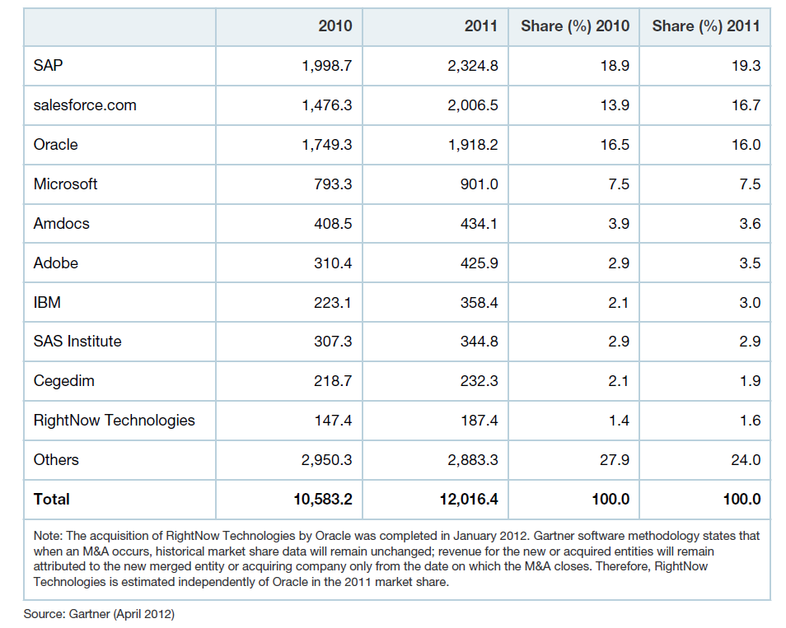
Global Software MI: Competitive Landscape Top Software Vendors
Total Software Revenue and Market Share of the 10 Leading CRM Vendors, 2010-2011 in $ million
- 12 -
Notes:
Sources:
Market Share Snapshot: CRM Software, 2011 Published: 26 April 2012

Slide 13
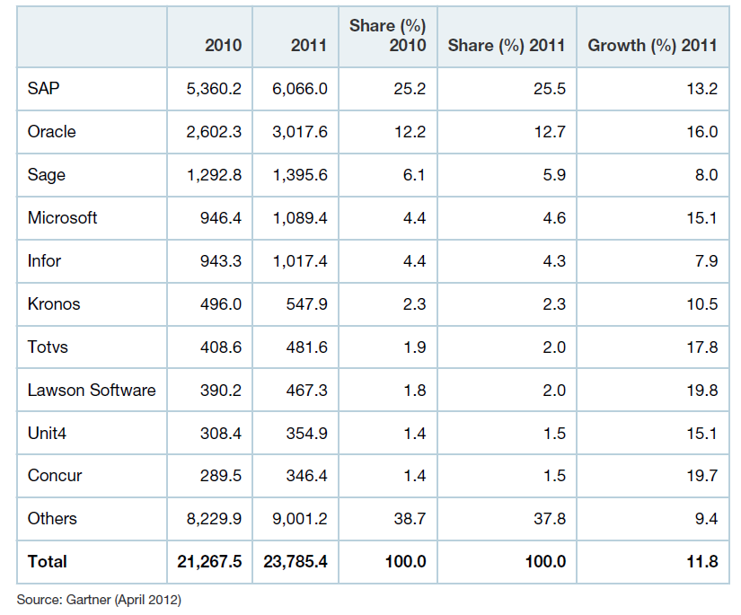
Global Software MI: Competitive Landscape Top Software Vendors
Top 10 ERP Software Vendors by Total Software Revenue, Worldwide, 2010-2011 in $ million
- 13 -
Notes:
Sources:
Market Snapshot: ERP Software, Worldwide, 2012 Published: 24 April 2012

Slide 14
Global Software Services MI: Table of Content
Market Overview
Competitive Landscape
Deals Space
Important Contracts
Business Trends
Technology Trends
Market Drivers
Market Future
Disclaimer:
The information presented in this report is based on data available in the public domain. If you find that it is incorrect, please let us know.
- 14 -

Slide 15
Global Software MI: Deals Important Contracts
Software Contracts till date
Existing Contracts (As of 1st Oct,2012)
Contracts Expiring in 2012
Contracts Expiring in 2013
- 15 -

Slide 16
Global Software Services MI: Table of Content
Market Overview
Competitive Landscape
Software License Resale Market
Deals Space
Flexible Subscription Deals
Software Licensing Model
Business Trends
Software Pricing Trends
Technology Trends
Multiple Computers Based on Form Factor
Market Drivers
Market Consolidation
Market Future
Disclaimer:
The information presented in this report is based on data available in the public domain. If you find that it is incorrect, please let us know.
- 16 -

Slide 17

Global Software MI: Business Trends Software License Resale Market
“On 3 July 2012, the European Court of Justice (EJC) ruled against Oracle, which had challenged UsedSoft’s marketing and sale of used Oracle licenses. The ruling states that a copyright holder’s exclusive distribution rights to a copy of software are now exhausted at first sale, whether it is distributed by physical medium or Internet download”
The EU ruling may result in more pricing competition for software licenses, maintenance and support. However, software buyers should approach pre-owned licenses with caution. Unless Oracle or other software vendors can provide further legal arguments to prevent it, the ruling reaffirms a secondary European market in pre-owned licenses from vendors such as discountlicensing. com or ValueLicensing.com in the U.K. and susensoftware and usedSoft in Germany.
What does it mean for IT procurement executives?
Before selling software, completely remove it from systems, as the copyright owner’s exclusive right of reproduction remains intact
If reselling licenses allows to reduce maintenance on shelfware, consider buying licenses individually, but recognize that doing so may reduce discounts
Track used license pricing to help in negotiations
Consider buying used licenses for European use, but ensure that the renewal of maintenance can be done at reasonable rates or evaluate third-party maintenance solutions
The ruling cracks the armor of major independent software vendors and empowers customers with a new option
Sale of pre-owned licenses could drive software pricing down. The maintenance and support market could become more competitive as third-party application maintenance and support providers such as Ciber, Rimini Street and Spinnaker support pre-owned licenses
Notes:
Sources:
Gartner: EU Ruling May Open Competition in Software License Resale Market Published: 10 July 2012

Slide 18
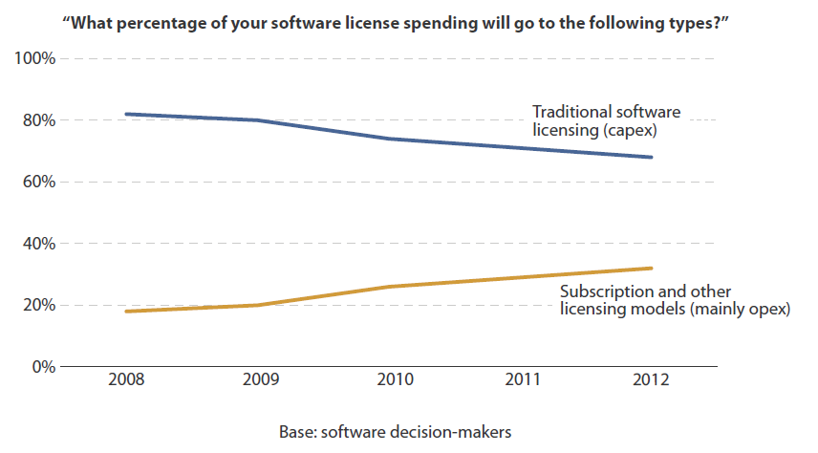
Global Software MI: Business Trends Flexible Subscription Deals
Flexible Subscription Deals Cannibalize Traditional Software Licensing
The increasing adoption of SaaS, typically offered in subscription-based business models, is clearly boosting this trend; however, more software vendors have also started to support subscription licensing for their traditional on-premises solutions, offering more flexibility for their clients.
The market appreciates this flexibility, as subscription-based licensing provides clients with a variety of benefits, including turning capital expenditure (capex) into operating expenditure (opex), reducing long-term financial risks, increasing scalability, and limiting (or removing) shelfware
Notes:
Sources:
Forrester- The New Software Paradigm: Buy-, Deploy-, And Pay-As-You-Like (August 1, 2012)

Slide 19
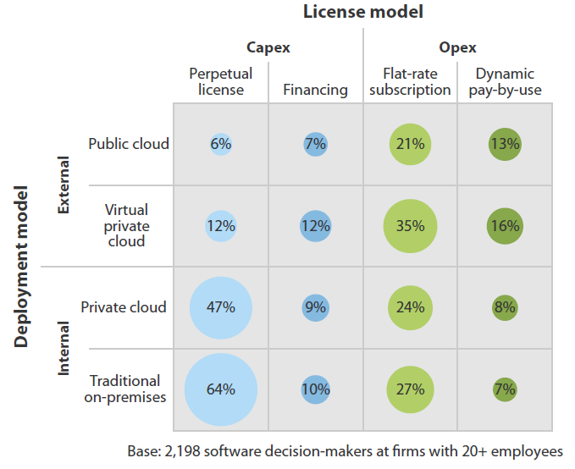
Global Software MI: Business Trends Software Licensing Model
Flexible Subscription Deals Cannibalize Traditional Software Licensing
Cloud users want more dynamic pricing-
To truly leverage the scalability and flexibility of a cloud deployment, SaaS customers want to move from typical monthly flat-rate subscriptions to true dynamic pay-by-use models. SaaS vendors need to find an appropriate metric, which on the one hand reflects the application usage and value for their customers and at the same time can be measured and monitored, e.g., for license entitlement and billing processes
On-premises customers want more dynamic pricing too-
The market for traditionally licensed software will continue to shrink as customers follow their preference for more flexible license models. It is interesting to see that 20% of our respondents prefer dynamic pay-by-use subscription models while only 7% are currently using this model for on-premises installation
Notes:
Sources:
Forrester- The New Software Paradigm: Buy-, Deploy-, And Pay-As-You-Like (August 1, 2012)

Slide 20
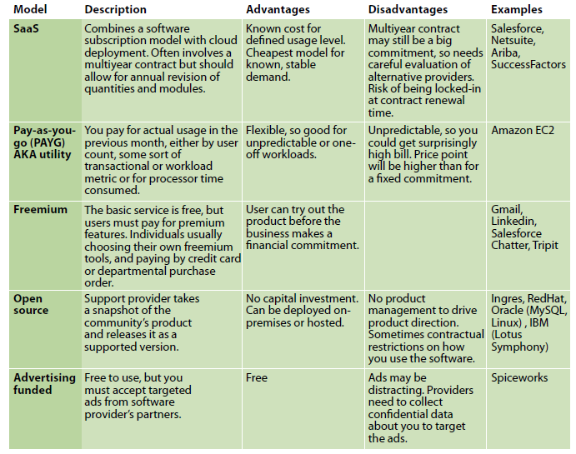

Global Software MI: Business Trends Software Pricing Trends
“Overwhelming majority of software pricing strategy managers agreed that flexible models with low entry cost such as SaaS, Freemium, and Utility would become more prevalent, at the expense of the traditional license plus maintenance model.” ~ Forrester Research
SaaS and pay-as-you-go models will become more common in the future.
Notes:
Sources:
Forrester Research: Software Pricing And Licensing Trends 2011

Slide 21



Global Software MI: Business Trends Consumers Own Multiple Computers Based on Form Factor
“While Apple owners tend to own more computers and more electronics devices, there is also a high correlation among Apple owners and more affluent consumer households. 36% of Apple computer owners reported household incomes greater than $100,000, compared to 21% of all consumers.”
~ Stephen Baker, VP Industry Analysis, Apple Inc.
One general purpose device is not enough for most consumers, and even for many business uses.
Laptop is increasingly becoming an all-purpose device. It still functions in that way, but for many applications, other devices work better.
Smart phone has become a mobile computer. It’s used for email, web browsing, reading, GPS navigation and more. It truly is a mobile computer, albeit the smallest one people will own.
Next up in size is the small tablet. iPad, Kindle, Nook and Sony Reader show examples of early entries into this market. This trend is expected to continue as consumers demand more capabilities from these tablet sized devices, as long as they can be delivered without sacrificing battery life. Of course, the laptop will continue to be the primary computing device. It has replaced the desktop for most applications, including high end gaming.
As applications adopt more and more social features, people will want the web in their living room. Beginnings of this trend can be seen as consumers connect gaming consoles to the web, not to play games with remote friends, but to surf the web. They watch YouTube, browse Facebook or watch Hulu. More and more, there will be applications designed for the living room, with multiple inputs and a much larger TV style screen.
The theme tying all these different devices together is that they are all general purpose devices. The difference is the form factor.
People want to carry the most efficient device for them at that time. It may be a phone, it may be a laptop, or it may be something in between.
- 21 -
Notes:
Sources:
http://www.annarbor.com/business-review/looking-forward-to-2011/
http://mashable.com/2009/10/05/mac-ownership-study/

Slide 22

Global Software MI: Business Trends Market Consolidation
Major Software Mergers & Acquisitions in Recent Years
IBM | TRIRIGA Inc., Netezza Corp., Unica Corp., Open Pages, Clarity Systems, PSS Systems, Datacap Inc., Core Metrics, Intelliden, Lombardi Software, Initiate Systems
Microsoft | Opalis Software, Canesta, Skype
SAP | Sybase Inc.
Oracle | Sun Microsystems, Ksplice Inc., Pillar Data Systems, Fatwire Software, Passlogix, Secerno
Leading software suppliers, IBM, Microsoft, Oracle and SAP, have been involved in over 100 M&As over last few years. Almost all of their acquisitions are of "desirables" i.e. companies desirable for their functionality and revenue stream and which continue to be aggressively supported and see new functionality being added.
Microsoft makes regular acquisitions of small vendors with relevant technologies or point products, avoiding large acquisitions (of vendors with $1 billion or more in revenues), because of concerns with anti-trust issues, something with which it is already all-too-familiar. Expect the Redmond giant to make selective acquisitions that do not conflict too much with its ecosystem strategy.
SAP may continue using partnerships at application level to drive new capability, and make more small-scale acquisitions that add/or improve capabilities in NetWeaver middleware tools that partners and customers need to build out last-mile solutions. Potential acquisitions in key commoditized infrastructure solutions might focus on user interface (UI) tools, business process management (BPM), extract transform & load (ETL) vendors, hosting, master data management (MDM), and others.
Oracle's software portfolio strategies focus on delivering integrated technology stack that supports vertical business application capabilities with both packaged apps and custom app tools. Expect the technology giant to acquire more parts of the commoditized infrastructure components like content archiving.
IBM may enter the packaged apps business through acquisitions. The most likely scenario involves smaller acquisitions of key ISVs, building on Websphere.
Notes:
Sources:
http://www.itbusinessedge.com/cm/community/features/articles/blog/in-2009-is-your-favorite-enterprise-software-supplier-desirable-distressed-or-a-candidate-for-divestment/?cs=23201
Forrester Report: The Last Hurrah For Big Software Acquisitions

Slide 23
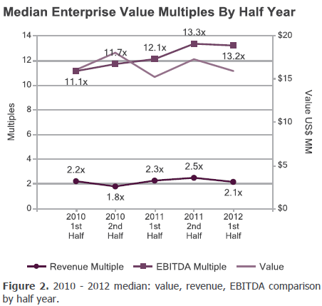
Global Software MI: Business Trends Market Consolidation
Berkery Noyes tracked 3,596 transactions between 2010 and 1st Half 2012
There was 1,207 disclosed financial terms, and calculated the aggregate transaction value to be $151.99 billion
Projection- Based on known transaction values, values of 2,389 undisclosed transactions projected to be to be $37.21 billion, totaling $189.20 billion worth of transactions tracked over the past two and a half years
Based on volume, the most active market segment that Berkery Noyes tracked over the past two and a half years was Niche Software with 1,640 transactions. This accounted for an aggregate transaction value of $69.99 billion
Notes:
Sources:
http://www.berkerynoyes.com/publication/trend-report/12half/software.aspx

Slide 24
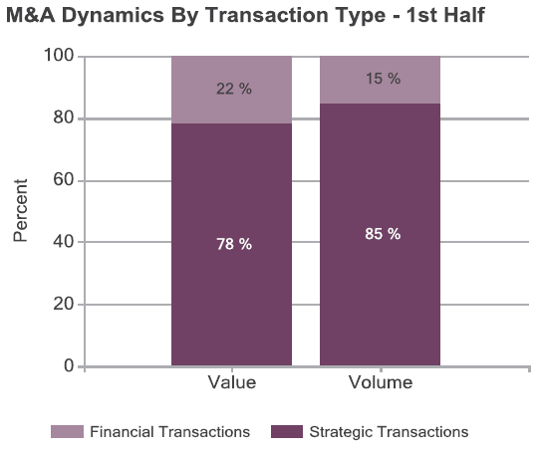
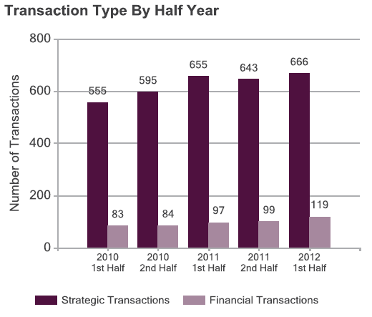
Global Software MI: Business Trends Market Consolidation
Berkery Noyes – Strategic vs. Financial Comparison
Note- Financial transactions are those financed by private equity, venture capital, and other investment firms. This includes acquisitions by portfolio companies of the investment firms
Notes:
Sources:
http://www.berkerynoyes.com/publication/trend-report/12half/software.aspx

Slide 25
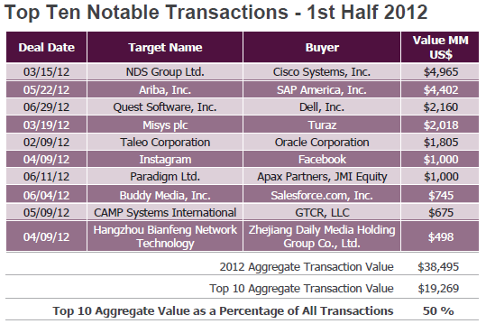
Global Software MI: Business Trends Market Consolidation
Berkery Noyes – Purchaser Analysis
Note- Transaction data based on announced date.
Notes:
Sources:
http://www.berkerynoyes.com/publication/trend-report/12half/software.aspx

Slide 26
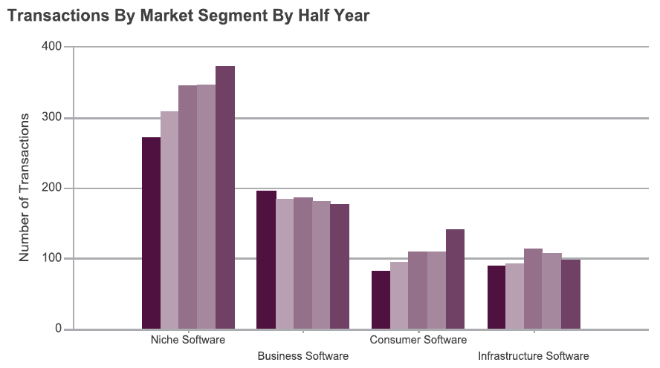
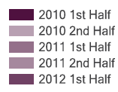
Global Software MI: Business Trends Market Consolidation
Berkery Noyes – Transaction Volume by Segment :: January 1, 2010 – June 30, 2012
Note- Presents transaction volume by market segment within the Software Industry from January 1, 2010 through June 30, 2012.
Number of transaction in Niche Software and Consumer Software market is showing an increasing trend where as Business Software market is showing a downward trend
Notes:
Sources:
http://www.berkerynoyes.com/publication/trend-report/12half/software.aspx

Slide 27
Global Software Services MI: Table of Content
CIO technology priorities
Enterprise Software Trends
Security Software Trends
Power Management Software
Open Source
Cloud Trend
Mobile Apps
Mobile Cloud
Portal Platform as a Service
Virtualization
Mobility
Social Media
Market Overview
Competitive Landscape
Deals Space
Business Trends
Technology Trends
Market Drivers
Market Future
Disclaimer:
The information presented in this report is based on data available in the public domain. If you find that it is incorrect, please let us know.
- 27 -

Slide 28
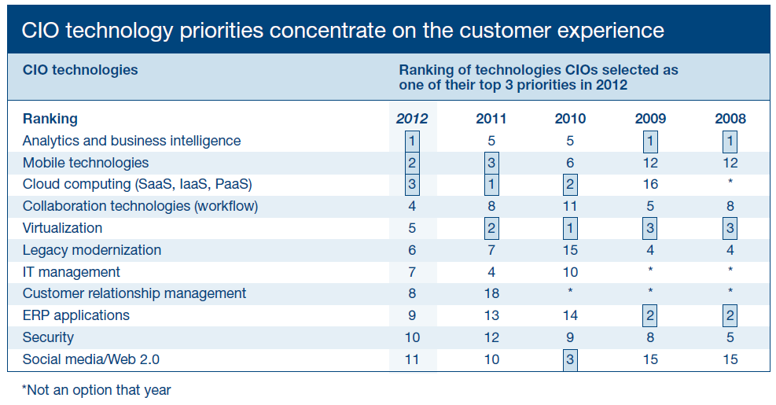
Global Software MI: Technology Trends CIO technology priorities
- 28 -
Notes:
Source:
Gartner- Amplifying the Enterprise: The 2012 CIO Agenda

Slide 29
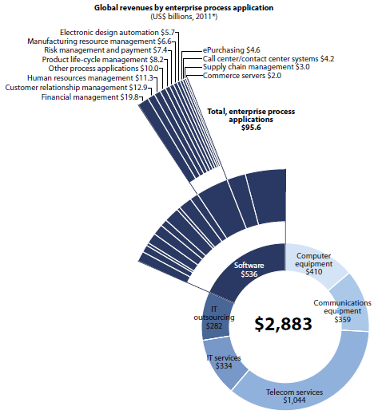
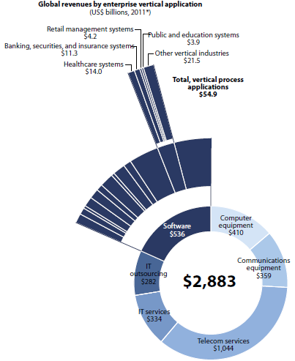
Global Software MI: Technology Trends Enterprise Software Trends
2011 Enterprise Process Applications By Product
2011 Enterprise Vertical Applications By Product
Enterprise vertical and enterprise process applications are expected to see growth acceleration of 9% in 2011 and, then rise to 12% in 2012.
- 29 -
Notes:
Source:
Forrester Report: What CEOs Of Small Software Companies Need To Do In 2011

Slide 30


Global Software MI: Technology Trends Enterprise Software Trends
Currently, the enterprise application software market represents approximately 42% of total enterprise software spending, while enterprise infrastructure software market represents the remaining 58% .
Enterprise software market is undergoing major technology and business model transitions that are expected to last beyond 2015. Throughout 2010, software vendors faced difficult product life cycle decisions and short-term pressure on price and margins, which impeded innovation.
Consumerization and Web 2.0 technologies are compelling forces. End users are exerting more control over their IT products and services than ever before, and this trend is anticipated to continue.
As end users gain more control, they will demand a more-integrated view, spanning multiple delivery models and work contexts. Users will also increasingly demand more consumer like delivery models that leverage technologies they already use day to day.
New license revenue has generally been declining in more-mature software markets, while maintenance and service components, the components that more directly refer to established customer bases, have grown.
Maintenance revenue will continue to grow as an overall percentage of total software spending, as 2010 price increases take hold and customers locked into multiyear maintenance contracts are unable to renegotiate in an effort to reduce costs.
Through 2015, most segments of the enterprise software market will continue to grow, but there will be fewer new purchases as enterprises align spending to augmentation, integration and modernization.
More enterprises would migrate to open source and service-oriented architecture (SOA), as older applications and systems become costlier to upgrade and maintain, and SaaS and cloud-based applications will continue to grow as alternatives to internally managed systems.
Larger vendors will benefit as suites, platforms and vendor "ecosystems" predominate.
- 30 -
Notes:
Sources:
Gartner Report: Key Issues for Technology and Service Providers: Enterprise Application Software, 2011
Gartner Report: Key Issues for IT Providers, Enterprise Infrastructure Software, 2011

Slide 31



Global Software MI: Technology Trends Security Software Trends
Global Security Software Market Trends:
As per Gartner, worldwide security software revenue witnessed a growth of 12% in 2010 to $16.5 billion, driven by a rebound in demand for such solutions.
While mature areas like endpoint security and web access management showed single-digit growth; security information and event management (SIEM) and secure web gateway products experienced double-digit growth
Symantec retained its market share lead and accounted for 18.9% of total security software revenue in 2010, while McAfee had a share of 10.4%.
Products within the security market are undergoing rapid evolution, in terms of both new delivery models, with security as a service showing increasing popularity, and new technologies being introduced, often by start-up companies
Smartphone Security Software Market Trends:
Global smartphone security software market is set to reach nearly $3 billion by 2017.
Fears over data loss through smartphones is driving the smartphone security market. Demand for smartphone security software within the corporate sector will be driven by the increasing use of smartphones for corporate communications. This in turn requires compliancy, information and network security, cost management and patch management.
Smartphone security software has become a significant revenue generator for vendors due to heightened perceived data security threat among smartphone users.
“With only about 23% of smartphone users having enabled security software, the smartphone security software market is laden with immense potential.” ~ Global Industry Analysts Inc.
Notes:
Sources:
http://www.onlinemarketing-trends.com/2011/06/online-security-software-grows-12-to.html
http://www.businesswire.com/news/home/20110621005846/en/Smartphone-security-software-market-set-grow-3
http://itcomweek.com/products/software/security-software-market-grew-12-in-2010-to-16-5-billion-gartner.html
http://www.prweb.com/releases/2011/4/prweb8354131.htm

Slide 32

Global Software MI: Technology Trends Power Management Software Trends
World Power Management Software Market earned revenues of $569.3 million in 2010 and estimates this to reach $1.57 billion in 2017, as power management software is expected to converge with next-generation technologies such as cloud computing and smart clouds.
Power management software provides data center operators with alerts and fault reports about power equipment, and collects power consumption data. It also offers clarity on power utilization and manages the energy usage of IT and facility resources for efficient data center operations
Power management software reduces and controls energy costs with real-time power usage monitoring and granular power usage breakdown. It accurately determines the data center's current capacity and forecasts future capacity. These product benefits will go a long way in easing end users’ recession-induced reluctance to adopt power management software.
Once the IT and ICT industries recover fully from the economic downturn, energy-efficient and smart technologies are likely be in high demand in the new economic environment.
The introduction of cloud computing and smart grids has boosted the demand for power management software, as energy monitoring, modeling, and management is necessary to ensure energy optimization.
The convergence of such software is expected to aid the evolution of smart cloud (computing), smart cities, and smart network intelligence to meet energy efficiency requirements and address environmental issues.
Market participants have many reasons to feel optimistic as the capital investment by the end users in this technology continues to rise.
With governments/regulators enforcing norms on energy wastage, companies are becoming increasingly acquainted with the operational expenditure-reducing advantages of power management software
Notes:
Sources:
http://www.frost.com/prod/servlet/press-release.pag?Src=RSS&docid=262302746

Slide 33

Global Software MI: Technology Trends Open Source
What does it mean for IT procurement executives?
“Open source and the cloud go hand-in-hand. If you look at innovation around the cloud and what the clouds are running, you see a lot of open source technology. Open source has helped get cloud computing to where it is today.” ~ Paul Daugherty, Accenture’s Managing Director of Advanced Systems and Technology
2011 marked the 20th anniversary of the Linux operating system. The year also saw a wave of new, innovative open-source technology that should erase any doubts that open-source software is ready for prime time.
The lineup of notable open-source products released this year includes Ubuntu's Unity user interface for the desktop, the LibreOffice application suite, the OpenStack cloud platform (the result of a partnership between Rackspace and NASA), the Asterisk 10 VoIP platform, and new releases of the Firefox browser and MySQL database.
In the “developing” world, India, China and Brazil show the best record of OSS adoption and development.
Globally, the U.S., Australia and the Western European countries — all economically developed — lead OSS development and adoption. While, at the forefront of OSS development in Asia are India, China, Japan and South Korea.
Apart from cost concerns, other key drivers behind the adoption of open source technology are higher quality, improved reliability, and better security/bug fixing of the software.
Open source is being used in business applications in areas like CRM, customer service, and finance and accounting.
Open source’s user-driven model, with a community that is expected to be participatory, leads to a more rapid evolution than with proprietary systems. This is one of the advantages of open source, and also one of the challenges. For example, ensuring that products integrate properly can sometimes be challenging when versions change rapidly.
Innovation in cloud, mobile, and social networking, are more often than not driven by open source software communities in those areas.
Open mobile platforms (Android for example), are driving innovation and gaining market share quickly over other mobile operating systems. That trend will continue to drive the comfort level and adoption rates of open source in other categories as well.
Notes:
Sources:
http://www.thehindu.com/sci-tech/article1099679.ece
http://openadvantage.redhat.com/2011/01/26/first-hand-insight-into-open-source-trends/

Slide 34
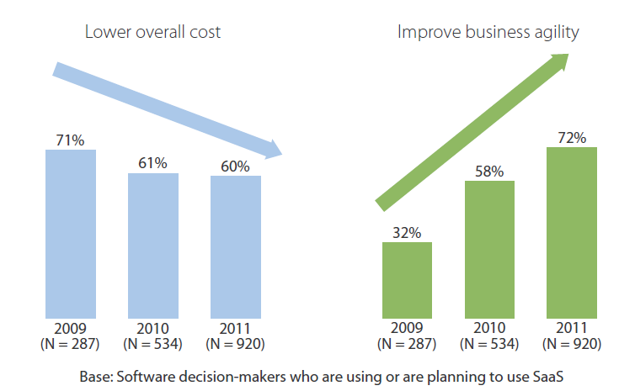
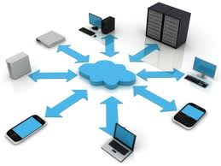
Global Software MI: Technology Trends Cloud Trend
“The IT industry is in the midst of an important transformative period as companies invest in the technologies that will drive growth and innovation over the next two to three decades. By the end of the decade, IDC expects at least 80% of the industry's growth, and enterprises' highest-value leverage of IT, will be driven by cloud services and the other 3rd Platform technologies ~
Frank Gens, senior vice president and chief analyst at IDC
Changing Perception about Cloud Benefits
Companies improve core business processes with new SaaS functionality
Companies are using cloud services for new, innovative technologies
Companies subscribe to cloud services to improve business
Forrester forecasts that the global market for cloud computing will grow from $40.7 billion in 2011 to more than $241 billion in 2020
To remain relevant in a cloud-based world, IT services providers should be aggressively building cloud-related service offerings to capture service opportunities in the CSB (Cloud services brokerage) market
Worldwide spending on public IT cloud services will be more than $40 billion in 2012 and is expected to approach $100 billion in 2016, according to IDC.
Over the 2012–2016 forecast period, public IT cloud services will enjoy a compound annual growth rate (CAGR) of 26.4%, five times that of the IT industry overall, as companies accelerate their shift to the cloud services model for IT consumption.
By 2016, public IT cloud services will account for 16% of IT revenue in five key technology categories: applications, system infrastructure software, platform as a service (PaaS), servers, and basic storage. More significantly, cloud services will generate 41% of all growth in these categories by 2016
- 34 -
Notes:
Sources:
Forrester Report: Sizing The Cloud
http://www.idc.com/getdoc.jsp?containerId=prUS23684912
Forrester Report- The Changing Cloud Agenda

Slide 35
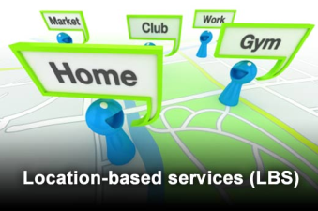



Global Software MI: Technology Trends Mobile Apps
As tablets and smartphones continue to take the world by storm and consumers demand more functionality and fun, software development outsourcing companies that specialize in this field will make a killing. If they prove their value, they might be eligible for a premium in comparison to other software dev providers for supplying an extremely timely service.
Location Based Services:
Gartner expects the total user base of consumer location-based services to reach 1.4 billion users by 2014. Location-based services strive to deliver features and functionalities in tune with the user's context, taking into account the user's location, personal preference, gender, age, profession, intention etc. Gartner analysts believe context-aware services are a key trend for mobile apps, and location is a key enabler of that.
Social Networking:
Mobile social networking is the fastest-growing consumer mobile app category of the 19 tracked by Gartner. They are becoming portals, transit hubs and cloud storage for increasing amounts of messaging and e-mail traffic, videos, photos, games and commerce
Mobile Search:
To bring mobile search to the next level, the app would allow users to take actions based on the result. Gartner advises search providers to build the experience around mobile to allow users access to immediate results and to take actions, given the short time span users have. Mobile device vendors might partner with or acquire promising search providers
Mobile Commerce:
Gartner expects the emergence of uniquely mobile functions, such as the ability to "check in" to a store to alert a retailer that you are there, or the ability to add items to a shopping cart simply by taking a photo of an item or bar code in the physical store. In the future, Gartner expects richer mobile commerce capabilities to expand from native apps to the mobile browser as HTML5 starts to be deployed, though this will happen at a much later stage
- 35 -
Notes:
Sources:
http://www.itbusinessedge.com/slideshows/show.aspx?c=87261&slide=5

Slide 36
Global Software MI: Technology Trends Mobile Cloud
Two of the four forces in Gartner's Nexus of Forces are particularly closely aligned — mobile and cloud.
From one perspective, cloud computing will play many roles in the implementation of mobile solutions.
From another perspective, mobile is itself a cloud — one containing millions of sensor equipped computing devices that can be harnessed to solve problems in new ways.
Mobile Cloud Opportunity in 2012
Examples include the new Google Maps Coordinate service for managing mobile workers, packaged cloud mobile applications from vendors like Blue Dot, and personal cloud storage systems, such as Dropbox and iCloud
Mobile SaaS
There are several different types of PaaS, all of which can be used in some way by mobile applications. Examples include Appcelerator-Cocoafish, Catavolt's mobile application tools and platforms such as Force.com. Popular mobile application platforms, such as Netbiscuits, are delivered as hosted cloud services
Mobile PaaS
Mobile IaaS
Many mobile SaaS services will be built on IaaS tools, although few IaaS services are mobile-specific. Telecom services, such as Skype and Google Voice, or SMS aggregators, such as Clickatell, can be seen as a form of IaaS. A few mobile-specific services, such as video streaming and application metrics collection, are delivered in IaaS forms
Mobile BPaaS
Many business process services will be accessed from mobile devices. Finegrained business process components (such as mobile payment, virtual loyalty cards and discount vouchers) will be incorporated into more-complex mobile applications
Special cloud services
A wide range of cloud services that don't fit neatly into classic cloud categories will be incorporated into mobile applications. Examples include information feeds (such as flight arrivals), social networking tools (such as Facebook and Twitter), and mapping/navigation services from Nokia and Google. In the future, we expect many advanced contextual mobile services to be constructed using such cloud components.
- 36 -
Notes:
Sources:
Gartner : The Future of the Mobile Cloud (Published: 6 September 2012)

Slide 37
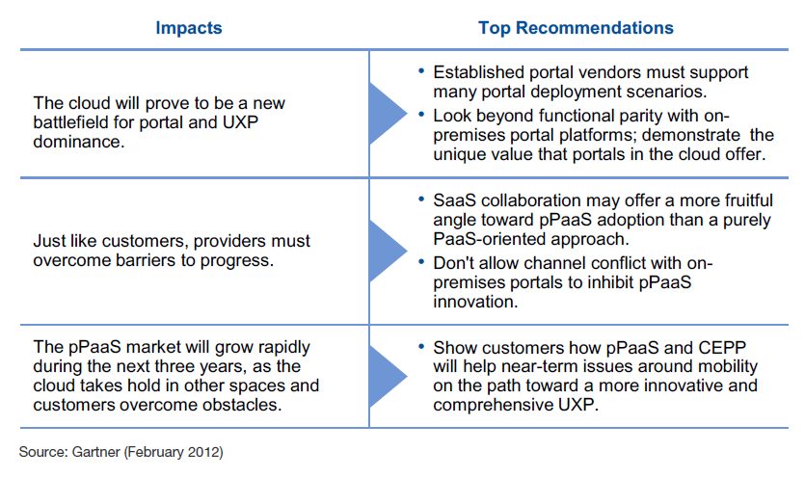
Global Software MI: Technology Trends Portal Platform as a Service
Organizations are increasingly looking toward cloud computing options for enterprise portals. As a platform that helps aggregate applications and unify the user experience across a disparate universe, the enterprise portal must play a crucial role as the cloud rolls into the enterprise. However, compared with other software categories, horizontal portals have made only slow adjustments to this new environment. Burgeoning customer demand, technology developments and competitive dynamics are about to change all that.
- 37 -
Notes:
Sources:
Gartner: The Rise of Portal Platform as a Service: The Vendor View Published: 10 February 2012

Slide 38
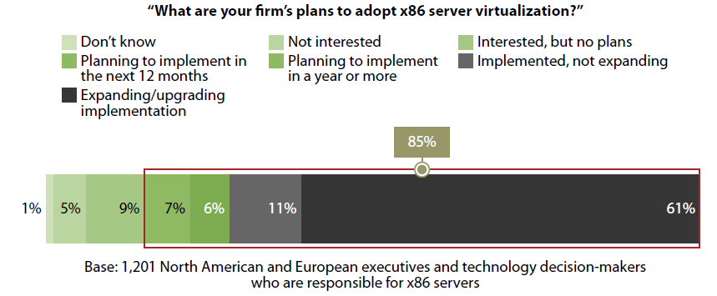
Global Software MI: Technology Trends Virtualization
Increasing adoption of Server Virtualization
Possible security threats
virtualization can create blind spots in network, and many security professionals don’t have the tools to inspect intra-virtual-machine (VM) communication
Increased vulnerability to insider threats
Inability to maintain security controls in a dynamic environment
Competitive Choices Mature- VMware’s competition has greatly improved in the past few years, and price is becoming a big differentiator. Enterprises have more choices today
Second Sourcing Grows: A growing number of enterprises are pursuing a strategy of “second sourcing” – deploying a different virtualization technology in a separate part of the organization
Pricing Models in Flux: trends toward private and hybrid cloud will ensure that virtualization pricing will continue to morph and challenge existing enterprise IT funding models
Penetration and Saturation: Virtualization hitting 50% penetration. Competition and new, small customers driving down prices.
Server Virtualization Trends, 2012
In 2011 despite the technology’s growing maturity and well-documented benefits, Forrester estimates that less than 20% of IT organizations have incorporated data virtualization technology. This was largely because:
Performance didn’t meet expectations 2)major vendors underplayed significance
According to Forrester in 2012 the market is growing with mature solutions supporting large deployments. Forrester predicts that total software revenues in data virtualization will grow to $8 billion by 2014
Steady adoption in Data Virtualization
- 38 -
Notes:
Sources:
Forrester Report: The CISO’s Guide To Virtualization Security January 12, 2012
Data Virtualization Reaches Critical Mass (June 15, 2011)
The Forrester Wave™: Data Virtualization, Q1 2012 (January 5, 2012)
http://blogs.gartner.com/thomas_bittman/2012/03/21/top-five-server-virtualization-trends-2012/

Slide 39
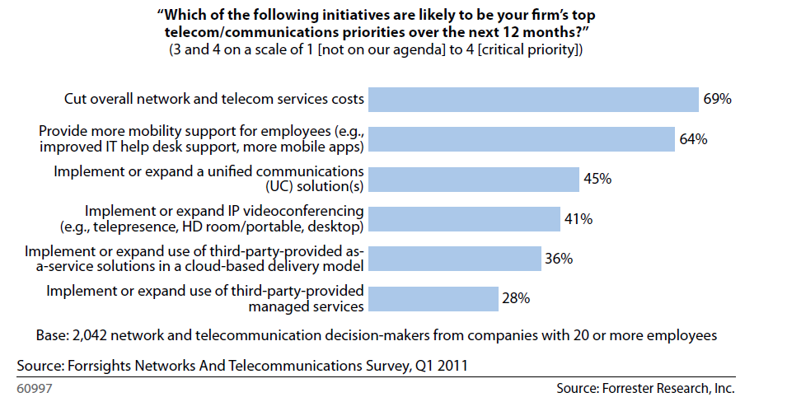
Global Software MI: Technology Trends Mobility
Firms Plan To Provide More Mobility Support For Employees
The volume of mobile transactions is growing at an incredible pace: PayPal processed $4 billion in mobile payments in 2011, dramatically up from an already impressive $750 million in 2010
Demand For Third-Party Mobility Services Is Growing, But The Market Is Still Emerging: The growing number of mobile devices, the evolution of more sophisticated devices (like the Apple iPad and Samsung Galaxy Tab), and the availability of network features make finding the right skills even more challenging — and an ever-moving target
Mobility will capture more internal development resources
Reflecting a lack of suitable mobile solutions from packaged software vendors, 47% of IT organizations in Forrsights Software Survey, Q4 2010, are developing or have concrete plans to develop their own mobile applications, such as mobile commerce, mobile marketing, and mobile access to back-office applications like enterprise resource planning (ERP)
2012 is the year that corporate app store adoption takes off
Enterprises, particularly large enterprises with broad BYOD policies, want to ensure employees have uniform access to corporate-approved mobile applications that will run similarly across all devices and operating systems.
- 39 -
Notes:
Sources:
Forrester: Emerging Markets And Technologies Drive Tech Industry Growth (January 26, 2012)

Slide 40


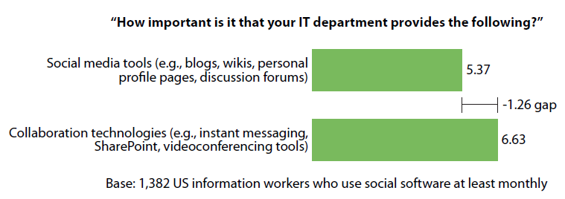
Global Software MI: Technology Trends Social Media
Businesses consolidate social media activities: 2012 is the year most business start to turn the corner on embracing and understanding social media marketing and using it more strategically. To break through the online noise, they need to stand out with their creative thinking around capitalizing on current buzz and trends. As the number of people using social media is increasing day by day, it is becoming more and more attractive market place. For that, brands need the right infrastructure and agile processes that will allow them to intuitively and immediately pick up on the marketing opportunities ~Companies will be looking for apps to get handle content overload
Advanced analytics : In 2012, we will see social media analytics companies releasing simplified SaaS (software as a service) tools for smaller agencies and brands to perform similar, less complex analytical functions. The tools will tell a story of not only what happened, but also of why it happened, and to model and predict the future
Enterprise Social Software
Workers Value IT-Provisioned Social Tools Less Than Other Collaboration Tech
IDC expects the CAGR in spending to hit 42.4% between 2011 and 2016 for "enterprise social collaboration" and "enterprise social networking" software . Enterprise social software allows organizations to engage with clients and facilitate the free flow of information and ideas internally
Forrester surveyed 4,985 US information workers and currently, 28% of workers use social software at least monthly- indicating the adoption is still in a nascent phase
The top reason why information workers are using social tools, accounting for 39% of the group, is because the barriers to using them are low and they solve their business problems
- 40 -
Notes:
Sources:
http://www.computerworld.in/news/idc-forecasts-strong-upward-trend-enterprise-social-software-spending-14092012
http://www.socialmediaexaminer.com/30-social-media-predictions-for-2012-from-the-pros/
The Forrester Wave™: Enterprise Social Platforms, Q3 2011 (August 24, 2011)
Forrester: The Enterprise 2.0 User Profile: 2011 (October 31, 2011)

Slide 41
Global Software Services MI: Table of Content
Market Overview
Competitive Landscape
Industry Growth Drivers & Challenges
Deals Space
Software Services Priorities
Business Trends
Cloud Factor
Technology Trends
Economic Crisis
Market Drivers
Market Future
Disclaimer:
The information presented in this report is based on data available in the public domain. If you find that it is incorrect, please let us know.
- 41 -

Slide 42
Global Software MI: Market Drivers Industry Growth Drivers & Challenges
Growth Drivers
Cloud driving the differentiation in delivery model.
Growth Challenges
Data volumes continue to grow and require increasing levels of protection.
Mobile apps and application development are driving the differentiation in platform.
Continuing demand in the software market from the developed world (especially the Tech Twelve Group - US, Australia, Canada, Denmark, Finland, Israel, Netherlands, New Zealand, Singapore, Sweden, Switzerland, & UK.
Security concerns over data on Cloud.
Huge software market for mobility devices is being created.
Big vendors continue buying (acquisition) spree to strengthen information management/integration portfolios.
New commercial models offering alternative ways to procure software, like SaaS, Pay-as- you-go, freemium, etc.
Growing demand for SaaS solutions in in enterprise process applications, security, employee-facing desktop applications, and certain information management applications.
Rising demand in information management software and enterprise vertical and enterprise process applications.
Several companies are showing resistance to SaaS because of various reasons: security concerns, Integration challenges with other applications, lack of customization, total cost of ownership, etc.
Software piracy and rampant copying issues.
- 42 -
Notes:
Sources:
http://blogs.forrester.com/andrew_bartels/11-01-10- tech_market_will_see_similar_growth_in_2011_as_in_2010_but_with_important_twists
Ovum Report: 2011 Trends to Watch – Storage, January 2011
http://www.techcrunchit.com/2010/06/15/idc-sees-pc-market-grow-by-19-8-in-2010/
http://www.edmontonnaoshweek.com/hardware/global-computer-hardware-industry-the-growth-of-individual-segments.html

Slide 43
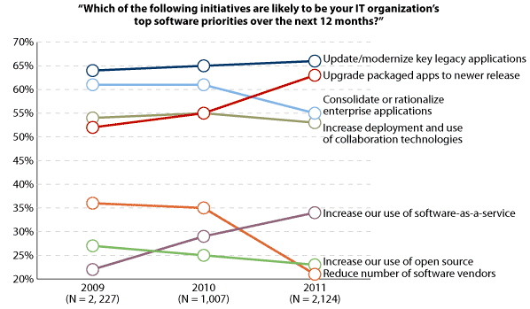
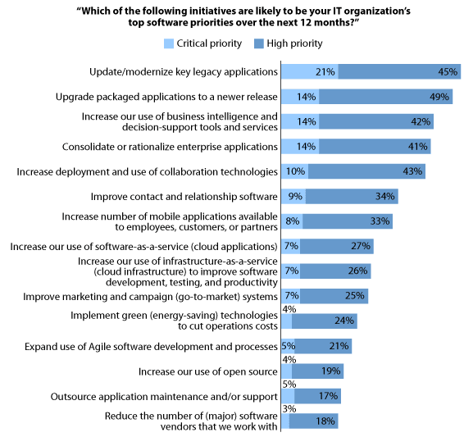
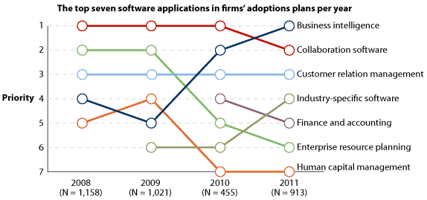
Global Software MI: Market Drivers Software Services Priorities
Software priorities are shifting post recession
Most Initiatives will focus on updating existing software solutions
No. 1 priority is BI; Admin back-office apps are in less demand
- 43 -
Notes:
Sources:
Forrester Report: Forrsights: The Software Market In Transformation, 2011 And Beyond

Slide 44
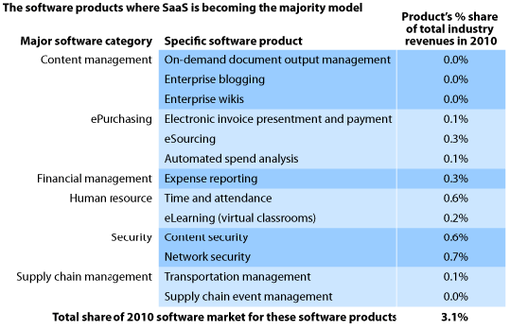
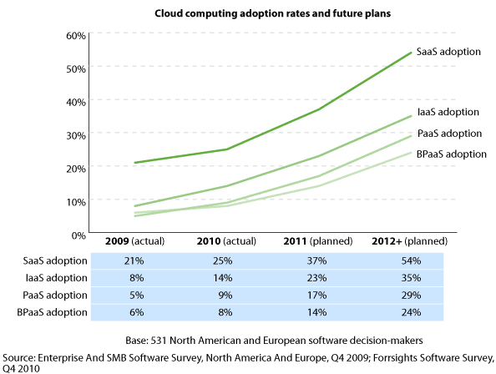
Global Software MI: Market Drivers Cloud Factor
Increasing adoption of SaaS, as offered in subscription-based business models, is on the rise; however, more and more software vendors have also started to support subscription licensing for their traditional on-premises solutions, offering more flexibility for their clients.
In content management, firms are more often than not purchasing on-demand document output management, blogging, and wikis as SaaS offerings.
While initially it was thought that cloud computing was mainly for small companies that could not afford internal IT skills and infrastructure, most of the benefits - implementation speed, remote user access, scalability, flexible financial business model – are just as appealing to large enterprises. More and more large enterprises are significantly adopting cloud services than small enterprises.
In some software markets, SaaS has already become the majority model for software sales and delivery.
- 44 -
Notes:
Sources:
Forrester Report: Forrsights: The Software Market In Transformation, 2011 And Beyond
Forrester Report: Which Software Markets Will SaaS Disrupt

Slide 45


Global Software MI: Market Drivers Economic Crisis
Impact on the financial sector: As financial institutions are by far the largest customer segment for the software industry, generating an estimated 30% of all software industry income, the credit crisis impacted software companies around the globe. However the impact was not as severe as some analysts expected.
Cyclical demand: The general assumption that the software industry is a very cyclical industry implies that software companies would see a decline even bigger than the financial industry, but that assumption is wrong. Software companies nowadays depend mostly on recurring subscription, support and maintenance revenue streams
Maintenance/subscription projects: The maintenance/subscription revenue stream is generally based on multi-year contracts and hence a very stable source of income. This explains why the credit crisis did not cause much mayhem among the Software Top 100, although there were many instances of modest single digit revenue declines due to decreased license sales
Because of the maintenance/ subscription projects the effect of economic downturn on financial sectors are not passed on to the software industry
- 45 -
Notes:
Sources:
http://www.softwaretop100.org/global-software-top-100-edition-2011-the-highlights

Slide 46
Global Software Services MI: Table of Content
Market Overview
Market Forecast
Competitive Landscape
Deals Space
Business Trends
Technology Trends
Market Drivers
Market Future
Disclaimer:
The information presented in this report is based on data available in the public domain. If you find that it is incorrect, please let us know.
- 46 -

Slide 47
Global Software MI: Market Future Market Forecast
Global software market value forecast: $ billion, 2010–15
Year | $ billion | % Growth
2010 | 265.4 | 7.1%
2011 | 284.1 | 7.0%
2012 | 300.3 | 5.7%
2013 | 317.3 | 5.6%
2014 | 336.1 | 5.9%
2015 | 356.7 | 6.1%
CAGR: 2010–15 |  | 6.1%
$ billion (e)
% growth
Year
In 2015, the global software market is forecast to have a value of $356.7 billion.
Comparatively, the European and Asia-Pacific markets will grow with CAGRs of 5.7% and 8.3% respectively, over the same period, to reach respective values of $109.4 billion and $80.3 billion in 2015.
Notes:
Sources:
Datamontior: Global Software Publication Date: November 2011

Slide 48
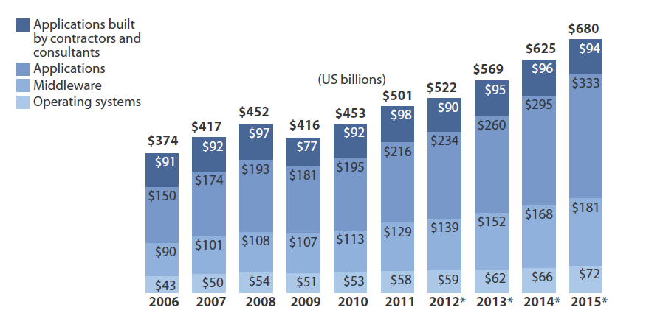
Global Software MI: Market Future Market Forecast
Fueled by a number of trends, such as software-as-a-service (SaaS), advanced analytics (including big data), and smart computing, the software market is expected to reach a volume of $522 billion in 2012 and to continue to outgrow the hardware, services, and telecom segments in 2013 (with about 9% year-over-year growth) and beyond
Notes:
Source:
Forrester Report: The New Software Paradigm: Buy-, Deploy-, And Pay-As-You-Like (August 1, 2012)

Slide 49
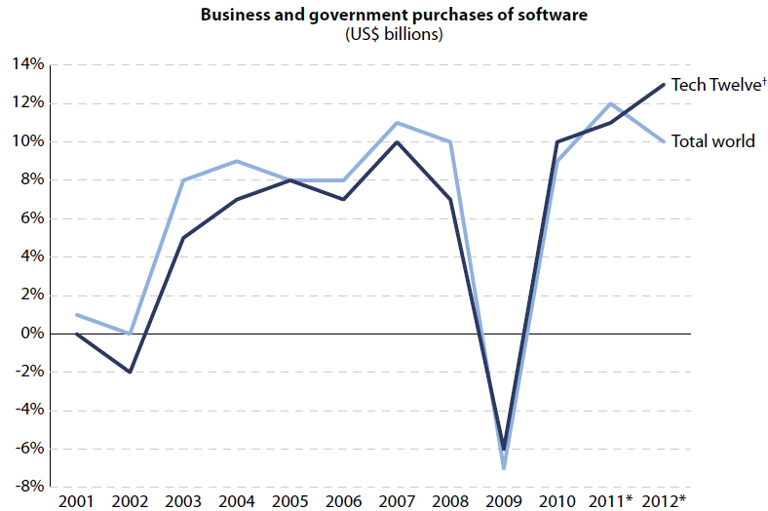
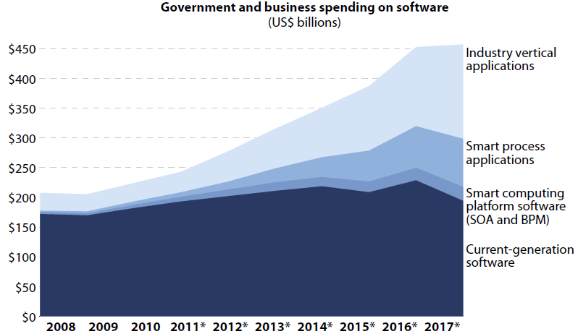
Global Software MI: Market Future Market Forecast
The Software Market Is Headed Back Towards Double-Digit Growth Rates
Smart Computing Software As Share Of US Software Market, 2008 To 2017
Smart Computing - addition of new technologies of real-world awareness and real-time analysis to software products – is more significant and transformative than Cloud Computing & SaaS.
Addition of Smart Computing capabilities and their integration into software create new opportunities for software vendors in two directions - Industry vertical applications & Smart Computing process applications.
Notes:
Source:
Forrester Report: What CEOs Of Small Software Companies Need To Do In 2011

Slide 50
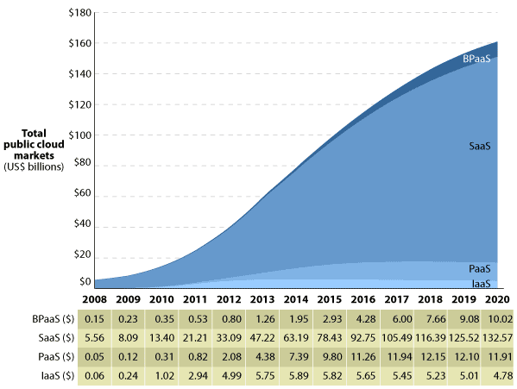
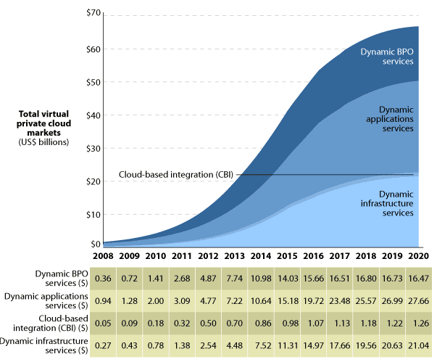
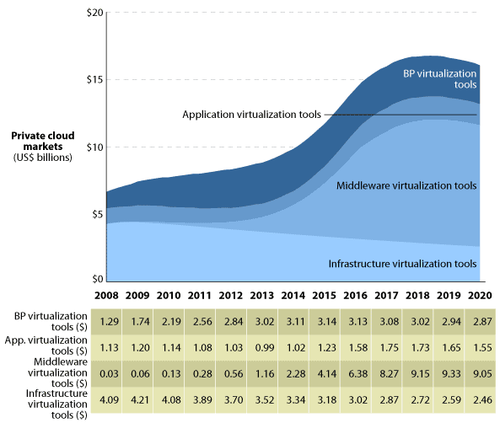
Global Software MI: Market Future Cloud Factor
With total revenues of more than $241 billion in 2020, cloud computing will evolve into a significant contributor to the size and growth of the tech industry overall.
Total size of public cloud market will grow from $25.5 billion in 2011 to $159.3 billion in 2020. Public cloud includes IT resources delivered as services via public Internet in a standardized, self-service and pay-per-use way.
Market for virtual private cloud solutions will grow from $7.5 billion in 2011 to $66.4 billion in 2020. Virtual private cloud offerings represent a hybrid business model of highly standardized public cloud offerings provided over public Internet and more customized privately hosted solutions.
Market for private cloud solutions will grow from $7.8 billion in 2011 to $15.9 billion in 2020. Private cloud solutions are distinct from public cloud and virtual private cloud solutions in that they are made up of licensed software tools rather than ongoing services.
Global Public Cloud Market Size, 2011 To 2020
Global Virtual Private Cloud Market Size, 2011 To 2020
Global Private Cloud Market Size, 2011 To 2020
- 50 -
Notes:
Source:
Forrester Report: Sizing The Cloud

Slide 51
Thank you for reading the report. Was the report useful to you? Do you need more research?
Please send your comments / suggestions to:
swati.malaker@tcs.com
aditi.royghatak@tcs.com

